Slide 1
REGular Expression (regex)

Slide 2
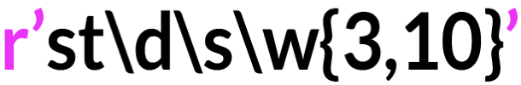
REGular EXpression or regex:
String that contains a combination of normal characters and special meta-characters
It describes patterns to find text or positions within a text

Slide 3
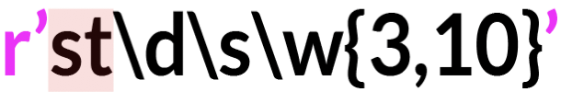
REGular EXpression or regex:
String that contains a combination of normal characters and special meta-characters
It describes patterns to find text or positions within a text
Normal characters match themselves ( st )

Slide 4
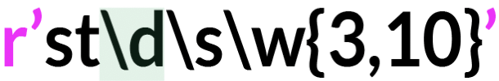
REGular EXpression or regex:
String that contains a combination of normal characters and special meta-characters
It describes patterns to find text or positions within a text
Special meta-characters represent types of characters ( \d , \s , \w ) or ideas ( {3,10})

Slide 5
REGular EXpression or regex:
String that contains a combination of normal characters and special meta-characters
It describes patterns to find text or positions within a text
Pattern: a sequence of characters

Slide 6
REGular EXpression or regex:
String that contains a combination of normal characters and special meta-characters
It describes patterns to find text or positions within a text
Find and replace text
Validate strings Very powerful and fast

Slide 7
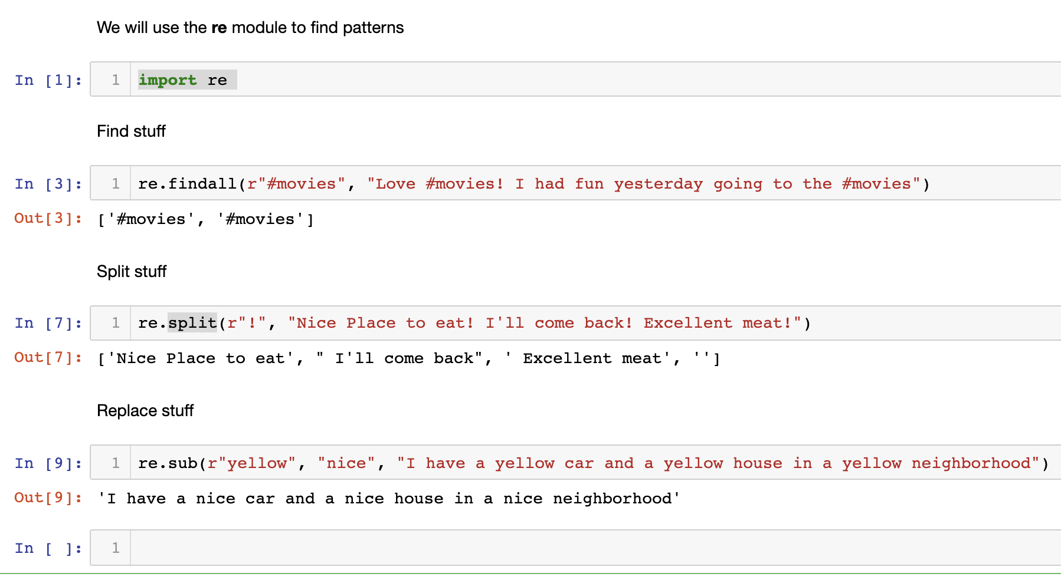
The re module

Slide 8
Meta-characters
Character | Description
\d | A digit: [0-9]
\D | A non-digit: [^0-9]
\w | A single word character: [A-Za-z0-9_]
\W | A non-word character: [^A-Za-z0-9_]
\s | A whitespace character: [ \t\r\n\f]
\S | A non-whitespace: [^ \t\r\n\f]

Slide 9
Repetitions
mypassword='password1234’
check if the following password complies with the following password rule :
A passwords should start with 8 characters and followed by 4 digits

Slide 10
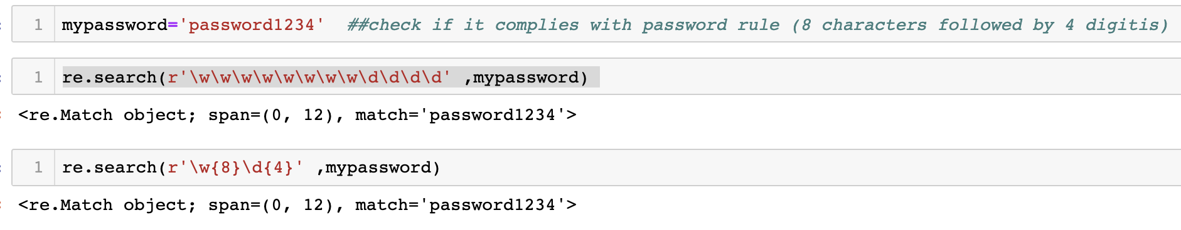
Repetitions
Quantifiers: {#}
A metacharacter that tells the regex engine how many times to match a character immediately to its left.

Slide 11
Repetition quantifiers
Quantifiers |  | Example
+ | once or more | ruby+ Match "rub" plus 1 or more ys
* | zero times or more | ruby* Match "rub" plus 0 or more ys
? | zero times or once | ruby? Match "rub" or "ruby": the y is optional
{n} | exactly n times | \d{3} Match exactly 3 digits
{n,} | n times at least | \d{3,} Match 3 or more digits
{n,m} | n times at least, m times at most | \d{3,5} Match 3, 4, or 5 digits

Slide 12
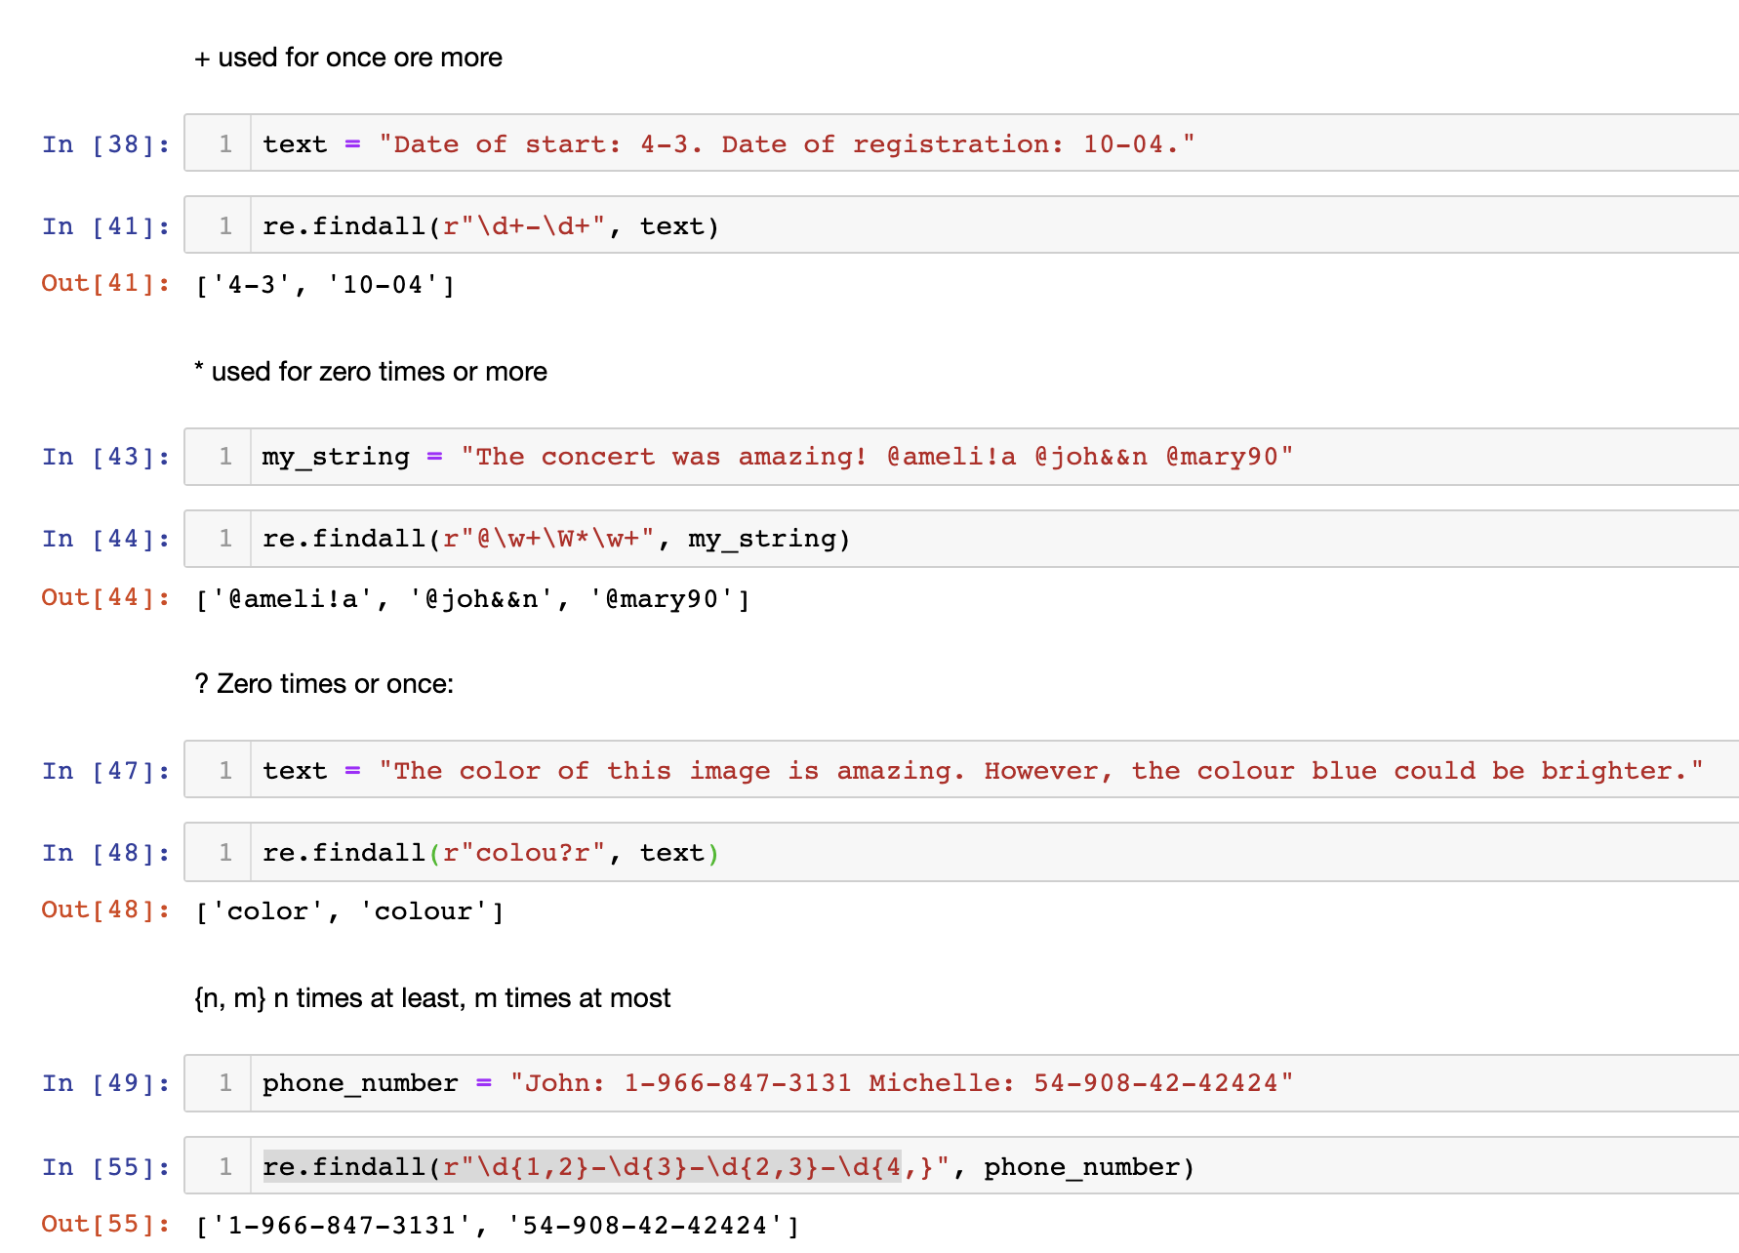
Repetitions

Slide 13
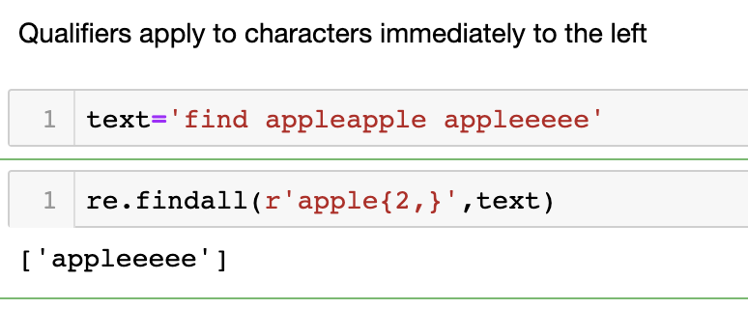
Repetitions
Quantifiers apply Immediately to the left
r"apple" : + applies to e and not to apple

